Slide 1
Multivariate Time Series & VAR Model
Concepts, Forecasting, and Implementation

Slide 2
Learning Objectives
Understand multivariate time series dynamics
Learn statistical analysis techniques for time-dependent data
Explore Vector Auto Regression (VAR) theory
Forecast multiple interdependent variables
Implement VAR in Python
Analyse a real-world case study

Slide 3
From Univariate to Multivariate
Univariate: One variable over time (e.g., GDP)
Multivariate: Multiple interdependent variables (e.g., GDP, Inflation, Interest Rate)
Captures cross-dependencies and joint behavior
Enables richer forecasting and causal inference

Slide 4
What is a Multivariate Time Series?
Definition: A collection of multiple time-dependent variables observed simultaneously over time
Mathematical Representation:
Yₜ = (y₁ₜ, y₂ₜ, ..., yₙₜ)' is an n × 1 vector
t = 1, 2, 3, ..., T (time periods)
n ≥ 2 (number of variables)
Why Multivariate Analysis?
The Real World is Interconnected:
Economic: GDP ↔ Inflation ↔ Unemployment ↔ Interest Rates
Financial: Stock Prices ↔ Trading Volume ↔ Volatility
Supply Chain: Demand ↔ Inventory ↔ Production ↔ Lead Time
Key Insight: Analysing variables in isolation ignores valuable information about their relationships and feedback effects

Slide 5
Key Characteristics & Advantages
Four Key Characteristics:
Temporal Dependence: Each variable depends on its own past values
Cross-Sectional Dependence: Variables correlated with each other contemporaneously
Lead-Lag Relationships: One variable may lead or lag another
Common Trends: Variables may share underlying factors and move together
Advantages Over Univariate Analysis:
✓ Capture Interactions: Account for feedback effects and dynamic relationships
✓ Improved Forecasting: Use information from all variables simultaneously
✓ Richer Analysis: Test causality, analyze shock transmission, decompose variance
✓ System-Wide View: Holistic understanding for policy analysis and scenario simulation

Slide 6
Why Vector Autoregression (VAR)?
VAR has become the workhorse model because:
Minimal Assumptions: No need for strong economic theory or causal direction
Symmetric Treatment: All variables treated as endogenous (mutually dependent)
Easy Estimation: OLS equation-by-equation - straightforward implementation
Rich Analytical Toolkit:
Granger Causality Tests
Impulse Response Functions (IRF)
Forecast Error Variance Decomposition (FEVD)
Historical Decomposition
Proven Performance: Good short-term forecasting, standard in central banks and research
Core Philosophy: "Everyone influences everyone, with lags" - let the data speak!

Slide 7
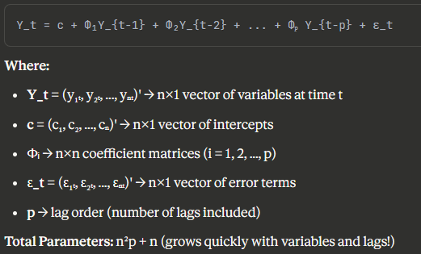
VAR Model - Basic Structure
Core Concept: Each variable in the system is regressed on its own lagged values AND lagged values of ALL other variables
VAR(p) Model - General Form:

Slide 8
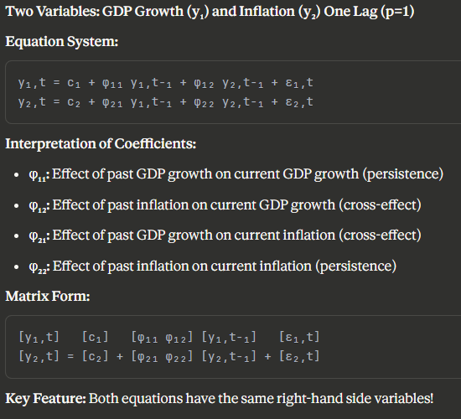
Bivariate VAR(1) Example

Slide 9
VAR Model Assumptions
Stationarity
All series must be stationary
Check with ADF test
Difference if necessary
No Serial Correlation in Residuals
Test with Durbin-Watson, Ljung-Box
Indicates correct lag order
Homoscedasticity
Constant variance of errors
Check with residual plots
No Multicollinearity
Variables should not be perfectly correlated
Can still have some correlation (that's the point!)

Slide 10
VAR Model Components
Endogenous Variables (Y_t)
Variables to be modeled
Each depends on past values of all variables
Example: [GDP, Inflation, Interest Rate]
Lag Order (p)
Number of past periods to include
Selected using IC (AIC, BIC)
Trade-off: fit vs. Complexity
Coefficient Matrices (A₁, A₂, ..., Aₚ)
Capture relationships between variables
Estimated using OLS (each equation separately)
Error Terms (ε_t)
White noise
Can be correlated across equations

Slide 11
VAR Estimation & Diagnostics
Estimation Method: Ordinary Least Squares (OLS) - equation by equation
Why OLS Works:
Each equation has identical regressors
OLS is efficient (equivalent to GLS)
Under normality: OLS = Maximum Likelihood Estimator

Slide 12
VAR Model Assumptions
Stationarity
All series must be stationary
Check with ADF test
Difference if necessary
No Serial Correlation in Residuals
Test with Durbin-Watson, Ljung-Box
Indicates correct lag order
Homoscedasticity
Constant variance of errors
Check with residual plots
No Multicollinearity
Variables should not be perfectly correlated
Can still have some correlation (that's the point!)

Slide 13
Application 1 - Granger Causality Testing
Definition: X Granger-causes Y if past values of X contain information that helps predict Y beyond what Y's own past can provide
Test Procedure:
Full Model: yₜ = α + Σβᵢ yₜ₋ᵢ + Σγᵢ xₜ₋ᵢ + εₜ
Restricted Model: yₜ = α + Σβᵢ yₜ₋ᵢ + εₜ
Hypothesis:
H₀: γ₁ = γ₂ = ... = γₚ = 0 (X does not Granger-cause Y)
Test: F-test or Likelihood Ratio test
Important Notes:
Not true causality - it's predictive causality
Bidirectional possible: X ⇒ Y and Y ⇒ X simultaneously
Sensitive to: lag length, omitted variables, sample period
Example: Does money supply Granger-cause inflation? If yes → past money growth helps forecast future inflation

Slide 14
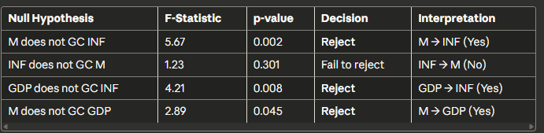
Granger Causality - Example Results
Question: Relationships between Money Supply (M), Inflation (INF), and GDP?
Test Results:
Findings:
Unidirectional: Money supply Granger-causes both inflation and GDP
Unidirectional: GDP Granger-causes inflation
No feedback: Inflation doesn't Granger-cause money supply
Policy Implication: Money supply is a leading indicator for inflation and economic activity

Slide 15

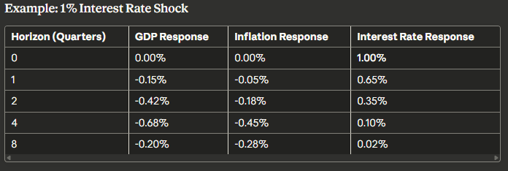
Application 2 - Impulse Response Functions (IRF)
Purpose: Trace the effect of a one-time shock to one variable on current and future values of all variables in the system
Mathematical Definition:
h = forecast horizon (how many periods ahead)
Key Features:
Shows dynamic adjustment path over time
Reveals persistence and propagation of shocks
Visualizes system interconnections
Standard tool for policy analysis

Slide 16
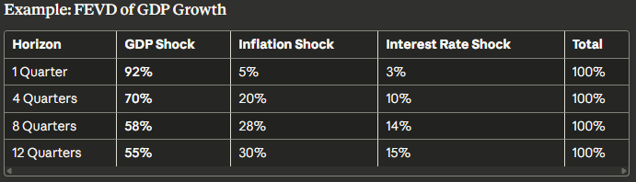
Application 3 - Forecast Error Variance Decomposition (FEVD)
Purpose: Decompose forecast error variance of each variable into proportions attributable to shocks from each variable in the system
Key Question: "What percentage of the h-step ahead forecast error variance in variable Y is due to innovations in variable X?"
Properties:
Percentages sum to 100% for each variable
Changes over forecast horizon
Own shocks typically dominate at short horizons
Complements IRF analysis
Interpretation:
Short-run: GDP fluctuations mainly self-driven (92%)
Long-run: Other variables explain 45% of GDP variance
Inflation increasingly important over time
Interest rate has modest but persistent impact

Slide 17
Application 4 - Forecasting with VAR
Why Use VAR for Forecasting?
Advantages:
✓ Incorporates interdependencies between variables
✓ Often outperforms univariate models (15-25% improvement for short-term)
✓ Provides system-wide consistent forecasts
✓ Captures feedback effects
Disadvantages:
✗ Many parameters → overfitting risk with small samples
✗ Performance deteriorates at long horizons
✗ Requires forecasting all variables together

Slide 18
Forecast Evaluation & Uncertainty
Point Forecasts + Uncertainty Intervals
Standard Errors:
Increase with forecast horizon
Account for parameter uncertainty and shock uncertainty
Use bootstrap methods for robust intervals

Slide 19
Industry Applications of VAR
Finance & Banking:
Portfolio risk management and asset allocation
Volatility spillovers between markets
Credit risk and systemic risk analysis
High-frequency trading strategies
Macroeconomics & Central Banking:
Monetary policy transmission analysis
Business cycle forecasting
Inflation targeting and policy rules
International shock transmission
Marketing & Business:
Advertising effectiveness across channels
Price-sales dynamics and promotions
Competitive response analysis
Multi-channel customer behavior

Slide 20
Industry Applications of VAR
Supply Chain & Operations:
Demand-inventory-production relationships
Bullwhip effect quantification
Supplier network risk analysis
Capacity planning with demand uncertainty
Energy & Commodities:
Electricity price forecasting
Oil-gas-coal price relationships
Renewable energy integration
Storage valuation and hedging

